Slide 1
KT Session -2 Applied Machine Learning
Terminology intensive session

Slide 2
Machine Learning (ML)
Machine Learning enables computers to learn patterns from data and make predictions.
It can be classified into:
supervised,
unsupervised, and
reinforcement learning.

Slide 3
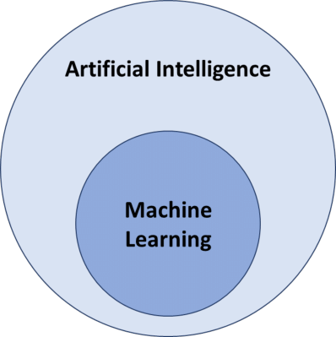

Slide 4
Supervised Learning
In supervised learning, the model learns from labeled data, where input-output pairs are provided.
Examples include spam detection and medical diagnosis using historical data.

Slide 5
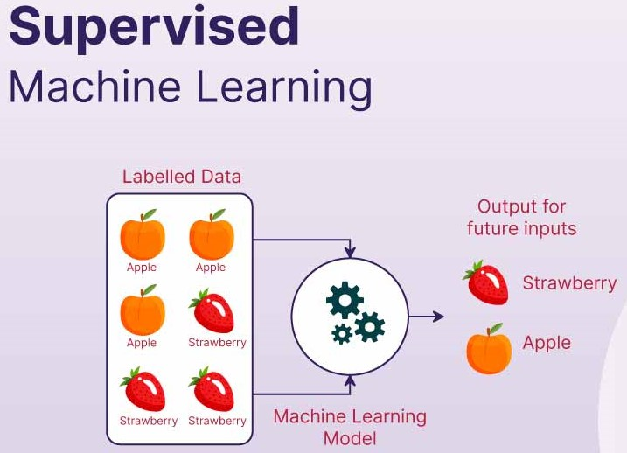

Slide 6
Unsupervised Learning
Unsupervised learning deals with unlabeled data, finding hidden patterns or clustering similar instances.
Examples include customer segmentation and anomaly detection.

Slide 7
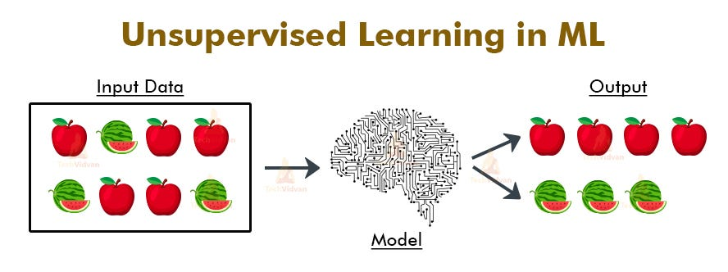

Slide 8
Reinforcement Learning (RL)
RL involves an agent learning to make decisions by interacting with an environment.
Applications include game AI, robotics, and autonomous driving.

Slide 9
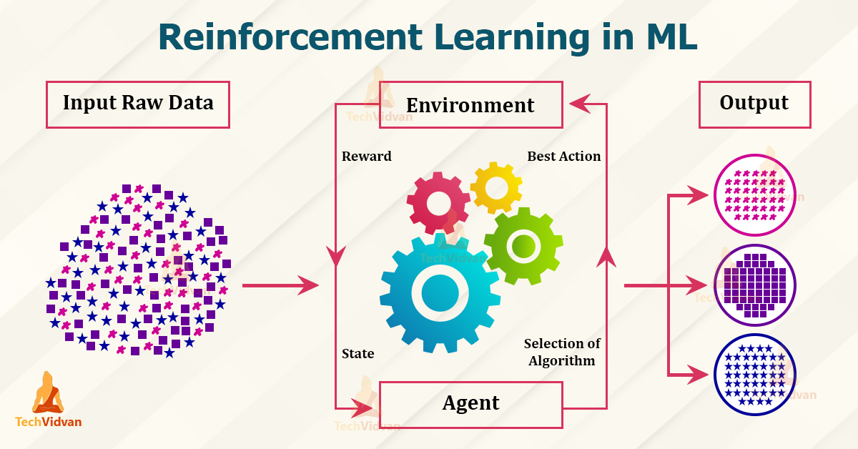

Slide 10
Classification
Classification assigns input data to predefined categories as output.
Examples include email spam detection and image recognition.

Slide 11
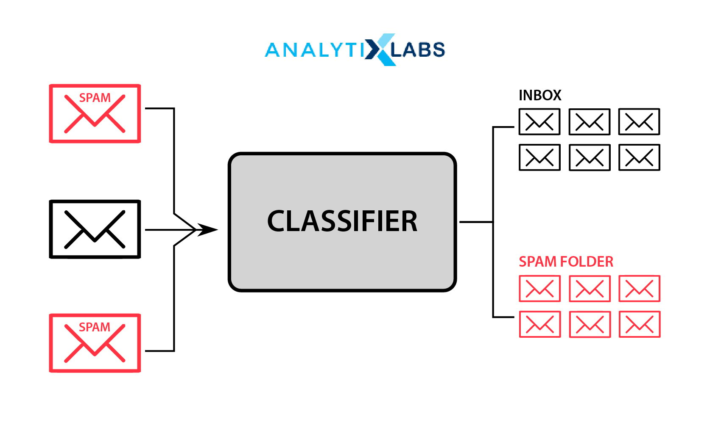

Slide 12
Regression
Regression predicts continuous values based on input features as the output.
Examples include house price prediction and stock market forecasting.

Slide 13
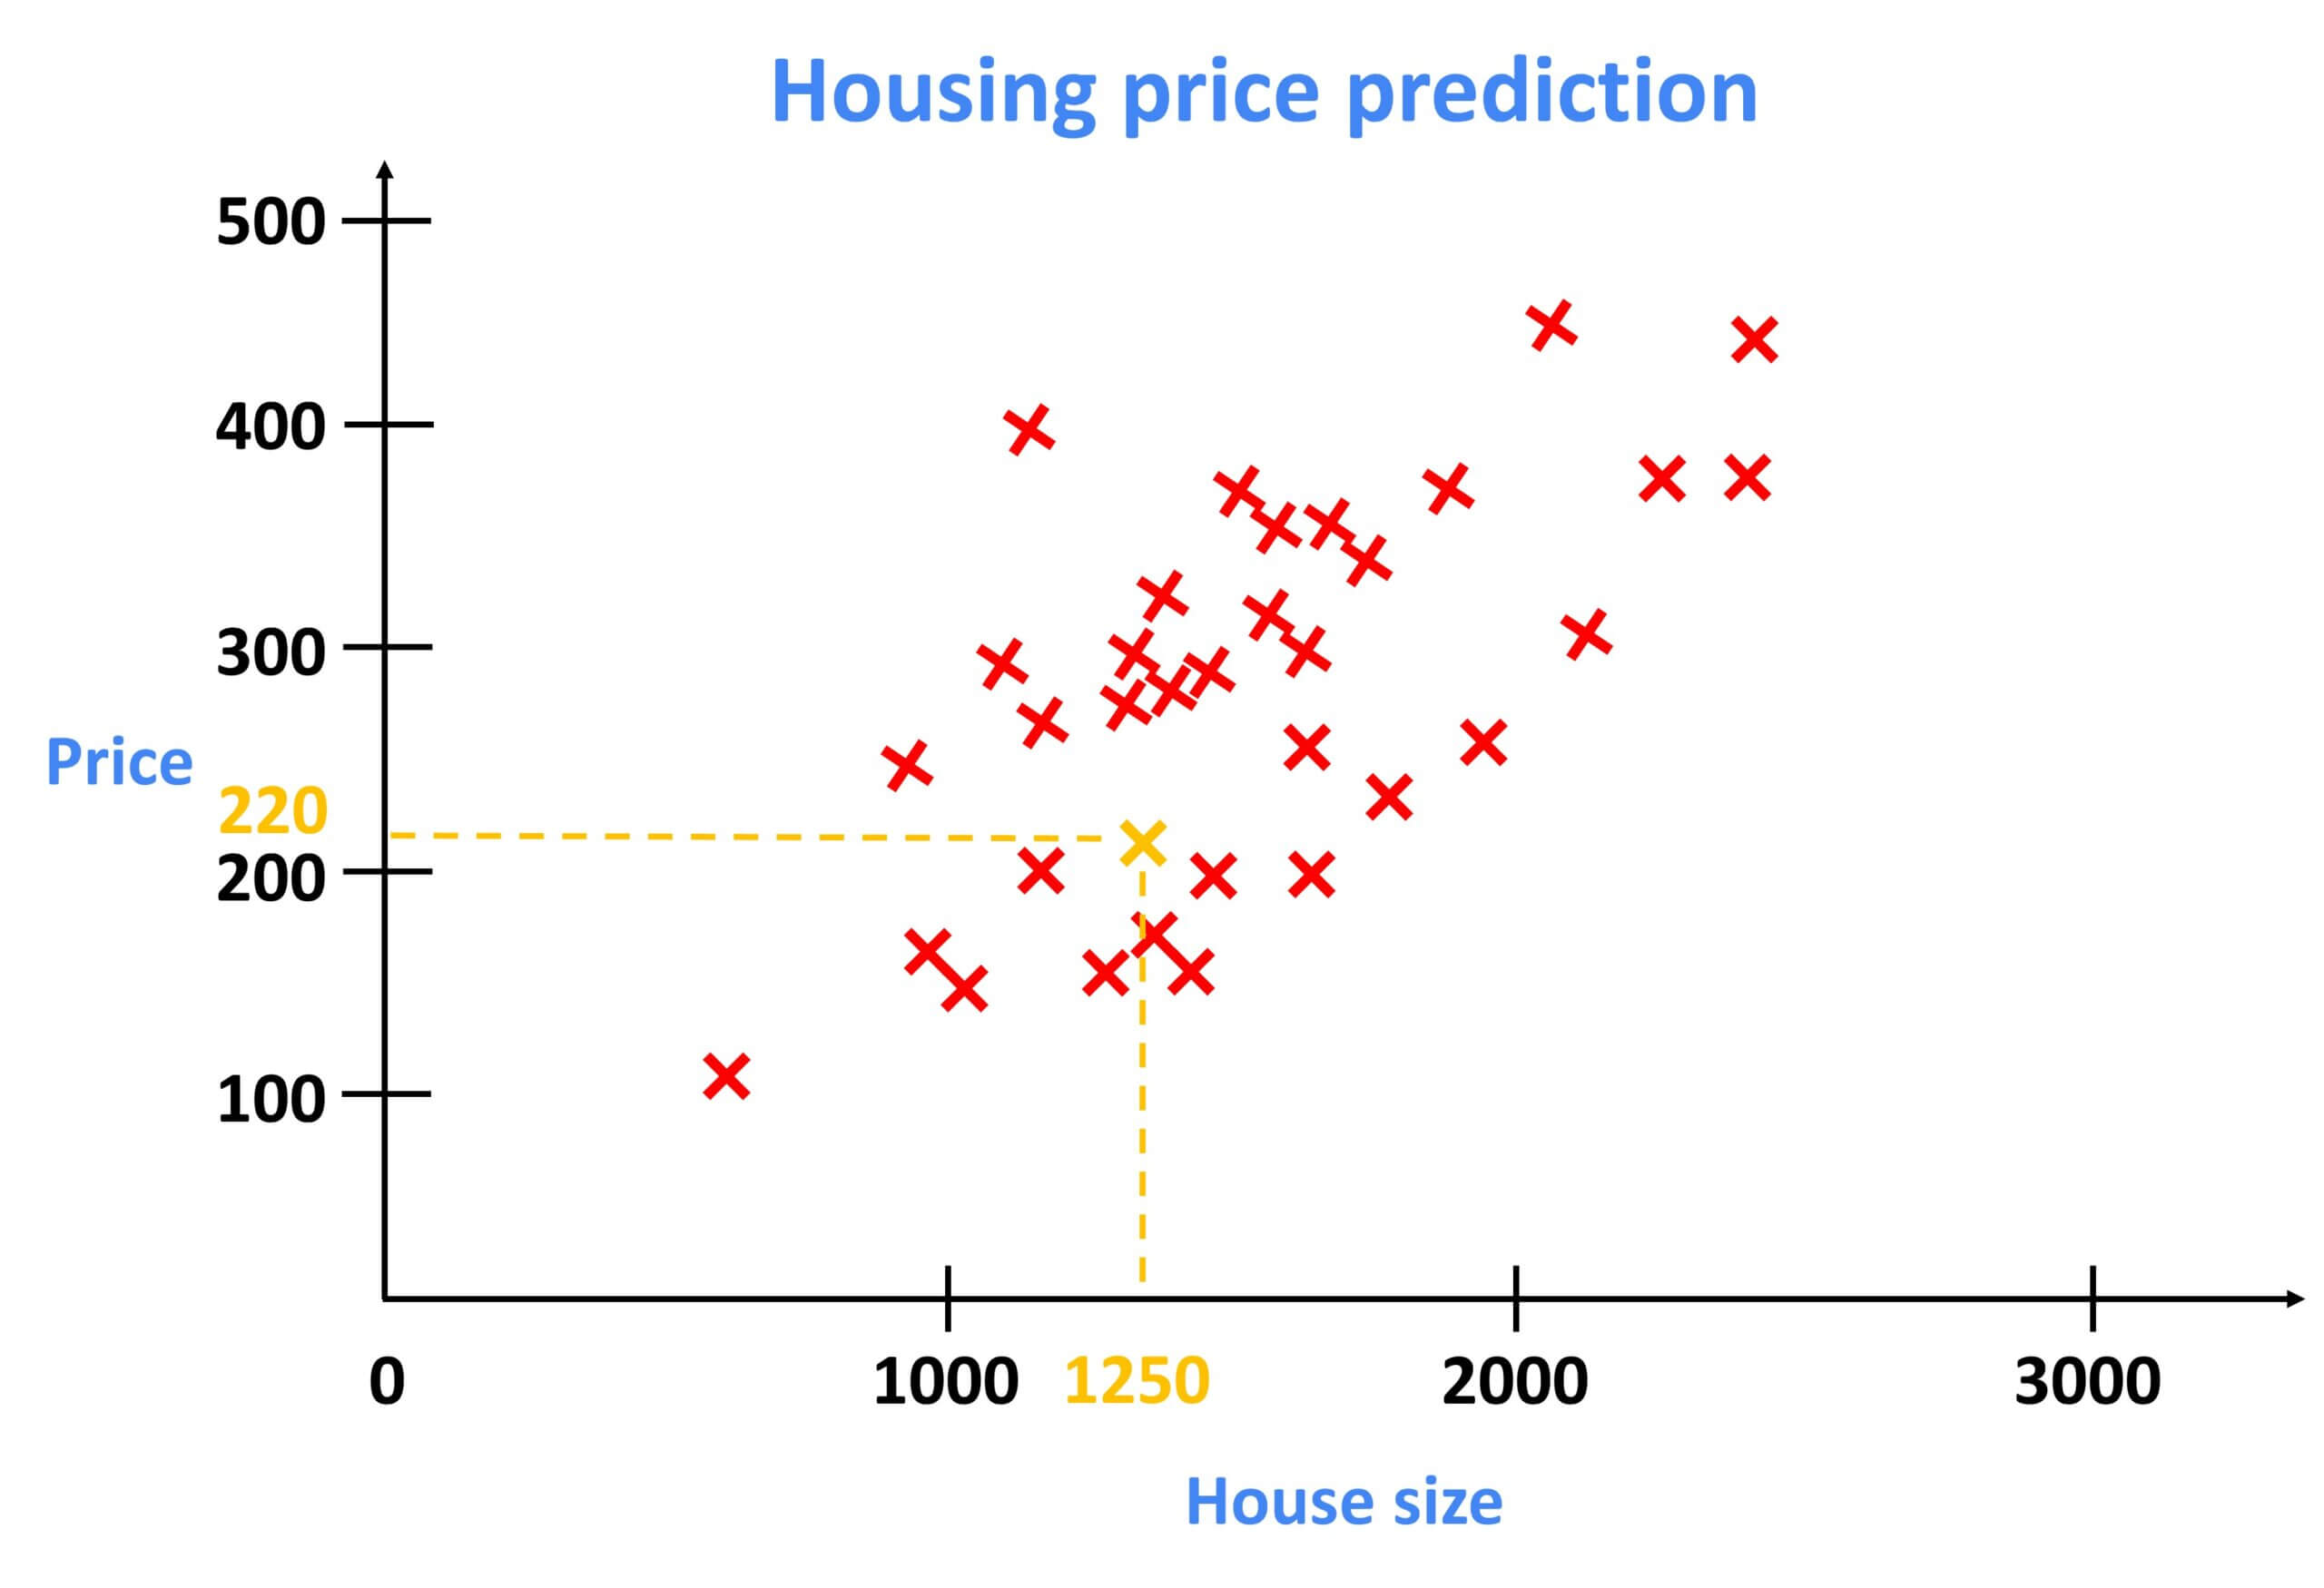

Slide 14
Bayesian Decision Theory
A probabilistic approach for decision-making under uncertainty. Used in spam filtering and risk assessment.

Slide 15
Loss Function
Measures how well a model’s predictions match actual values. Common loss functions include Mean Squared Error (MSE) and Cross-Entropy Loss.

Slide 16
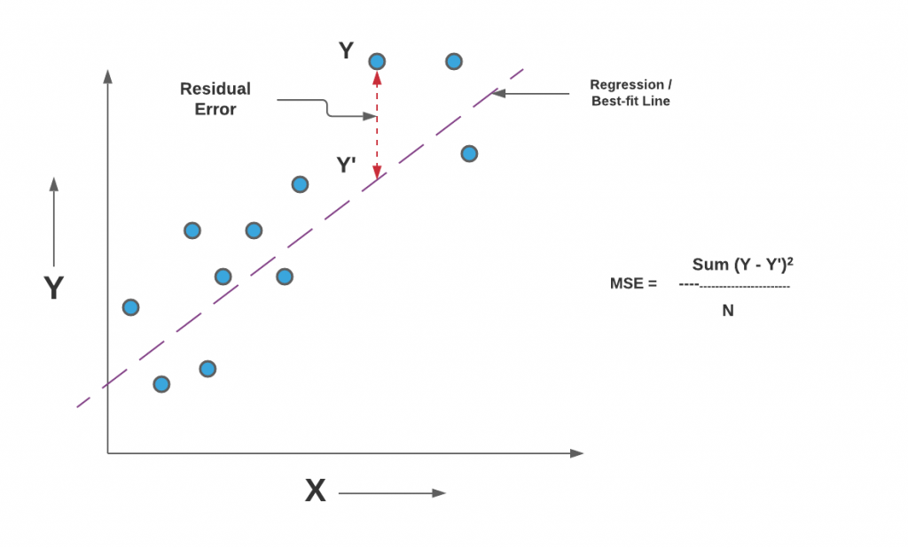

Slide 17
Association Rules
Finds relationships between variables in large datasets, basically to devise the frequently bought together items.
Example: Market Basket Analysis for retail businesses.

Slide 18
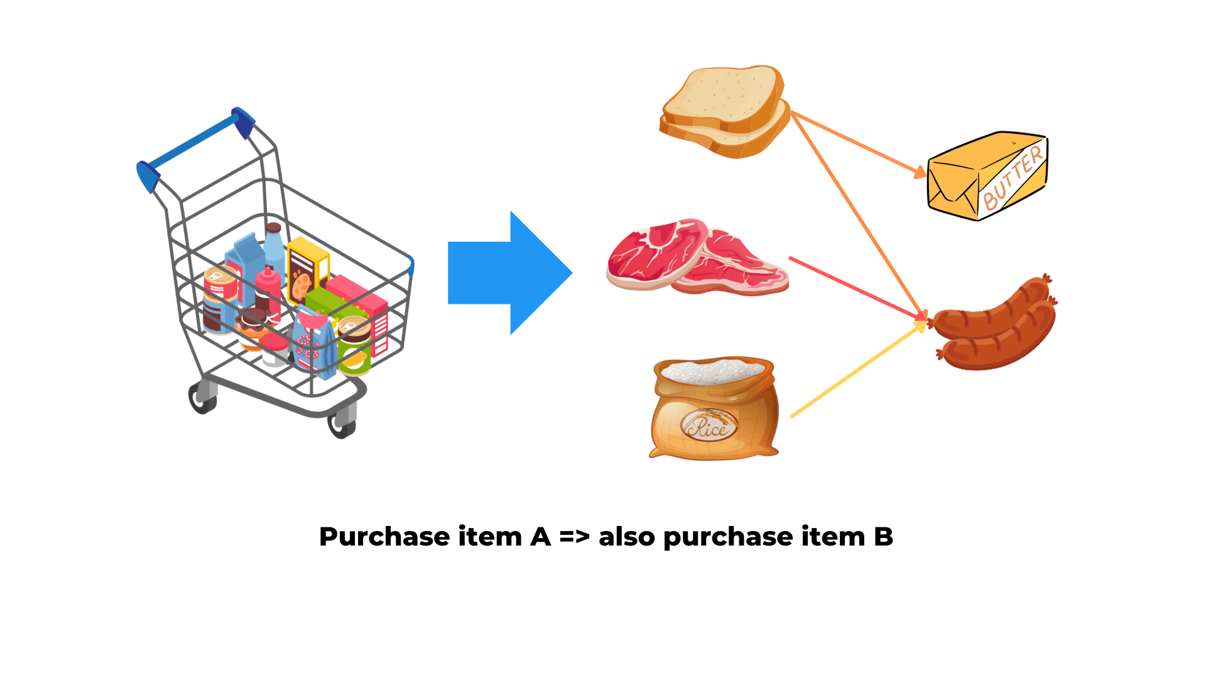

Slide 19
Maximum Likelihood Estimation (MLE)
A statistical method to estimate model parameters by maximizing likelihood. Used in logistic regression and probabilistic models.

Slide 20
Bernoulli Distribution
A probability distribution for binary outcomes (success/failure).
Example: Coin flips and email spam classification.

Slide 21
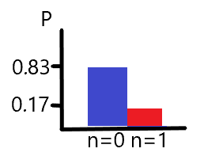

Slide 22
Multinomial Distribution
A generalization of the Bernoulli distribution for multiple outcomes.
Used in text classification and sentiment analysis.

Slide 23
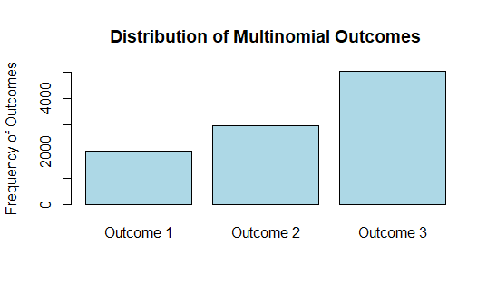

Slide 24
Gaussian (Normal) Distribution
A symmetric probability distribution used in statistical modeling. Common in finance and signal processing.

Slide 25
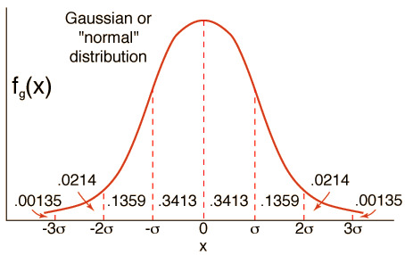

Slide 26
Bias-Variance Tradeoff
A tradeoff between model complexity and accuracy.
Balancing bias and variance prevents overfitting and underfitting.

Slide 27
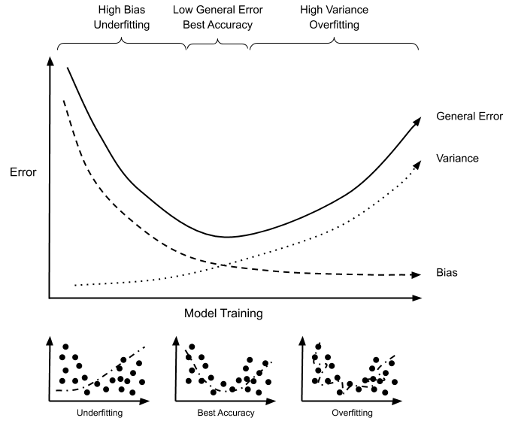

Slide 28
K-Nearest Neighbors (KNN)
A simple classification method that assigns labels based on nearest neighbors. Used in recommendation systems.

Slide 29
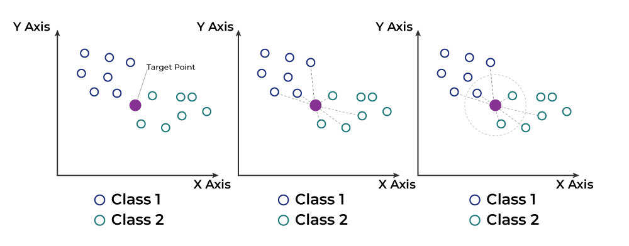

Slide 30
Clustering
Groups similar data points together. Used in customer segmentation and anomaly detection.

Slide 31
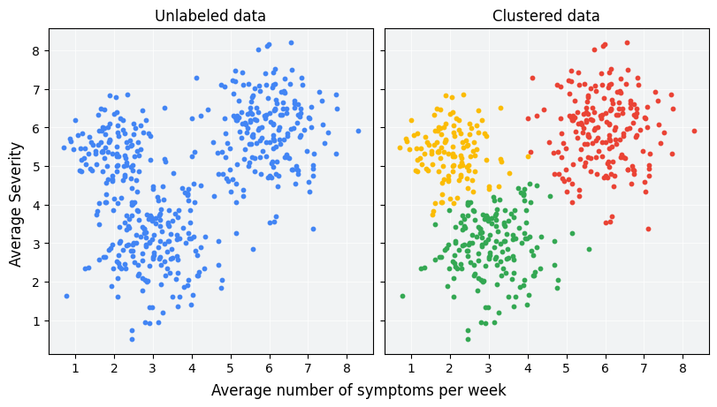

Slide 32
K-Means Clustering
A popular clustering algorithm that partitions data into k clusters. Used in customer segmentation.

Slide 33
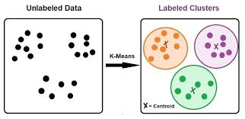

Slide 34
Principal Component Analysis (PCA)
A dimensionality reduction technique that retains variance. Used in image compression and finance.

Slide 35
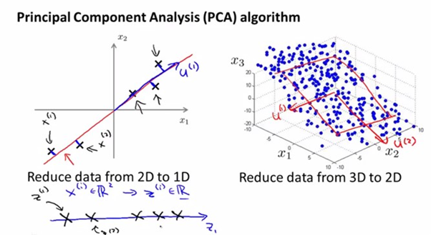

Slide 36
Logistic Regression
A classification algorithm based on probability. Used in medical diagnosis and fraud detection.

Slide 37
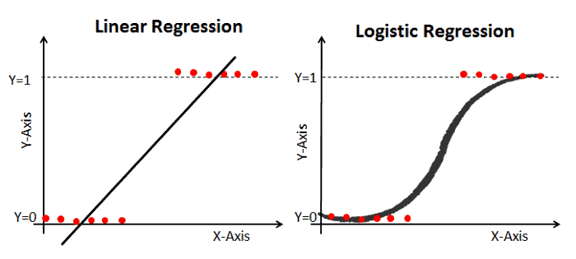

Slide 38
Artificial Neural Networks (ANNs)
A model inspired by the human brain. Used in image recognition and speech processing.
A feed forward class of Neural Networks.

Slide 39
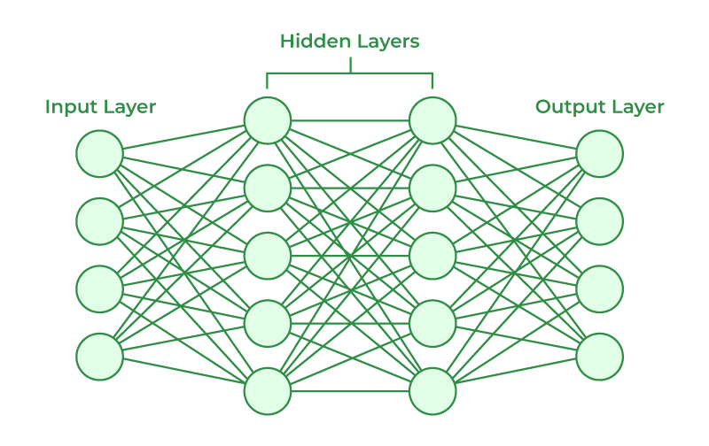

Slide 40
Perceptron
A simple neural network unit for binary classification. Basis for deep learning models.
Just contains an input and an output layer.

Slide 41
Multilayer Perceptron (MLP)
A feedforward neural network with multiple layers. Used in deep learning applications.

Slide 42
Backpropagation Algorithm
A method to update neural network weights. Enables deep learning advancements.

Slide 43
Decision Trees
A tree-like model for decision-making. Used in credit scoring and medical diagnosis.

Slide 44


Slide 45
Classification Trees
A type of decision tree for categorical labels. Example: Email spam detection.

Slide 46
Regression Trees
A decision tree that predicts continuous values. Used in stock price prediction.

Slide 47
Pruning
Reduces tree size to prevent overfitting. Helps improve decision tree accuracy.

Slide 48
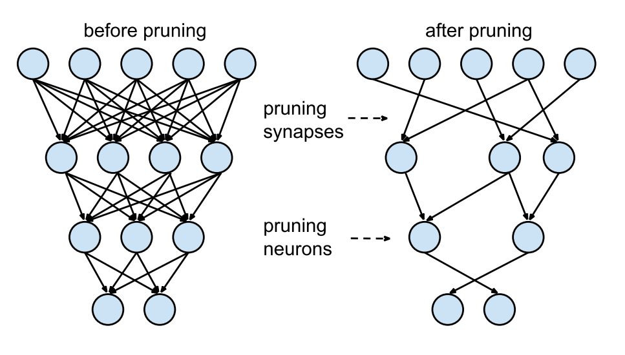

Slide 49
Random Forests
An ensemble of decision trees that improves accuracy. Used in recommendation systems.

Slide 50
